Slide 1
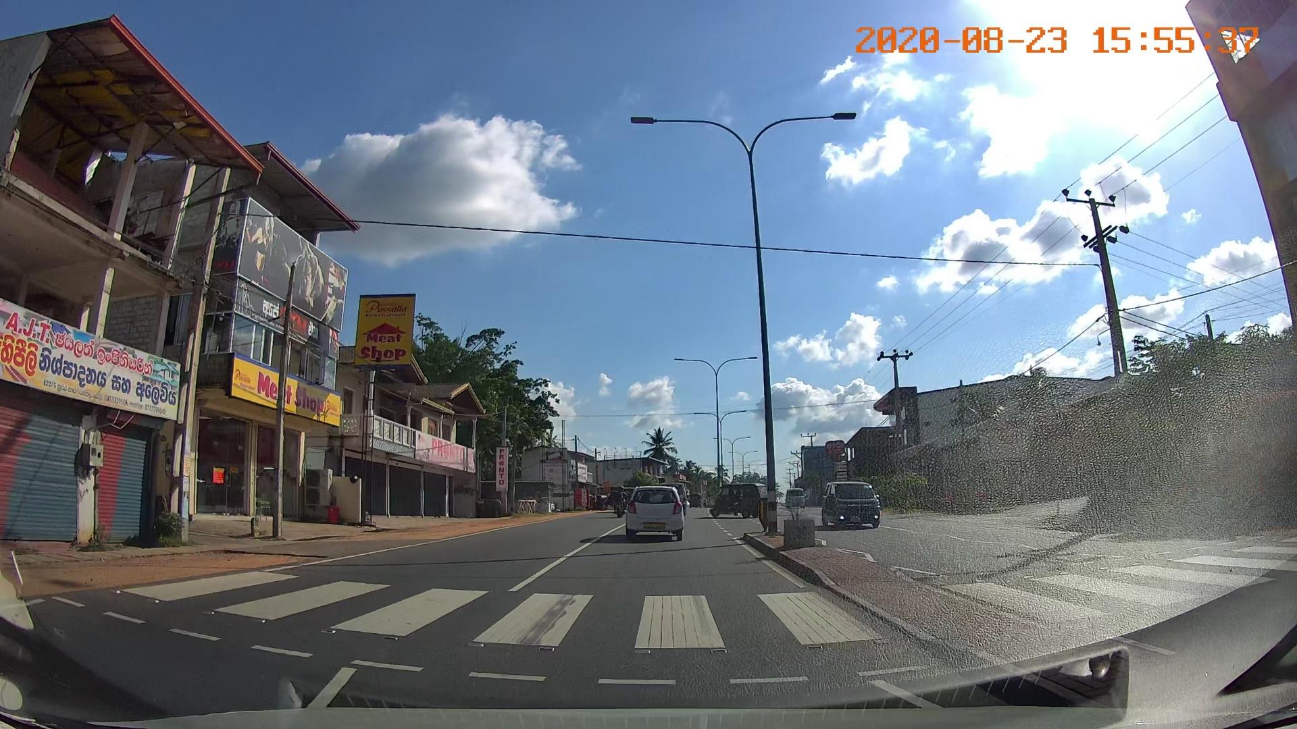
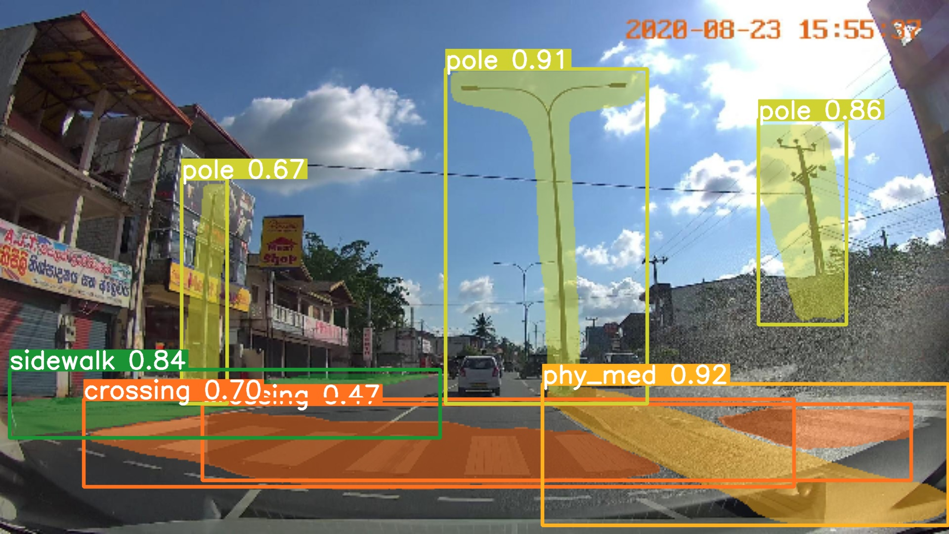
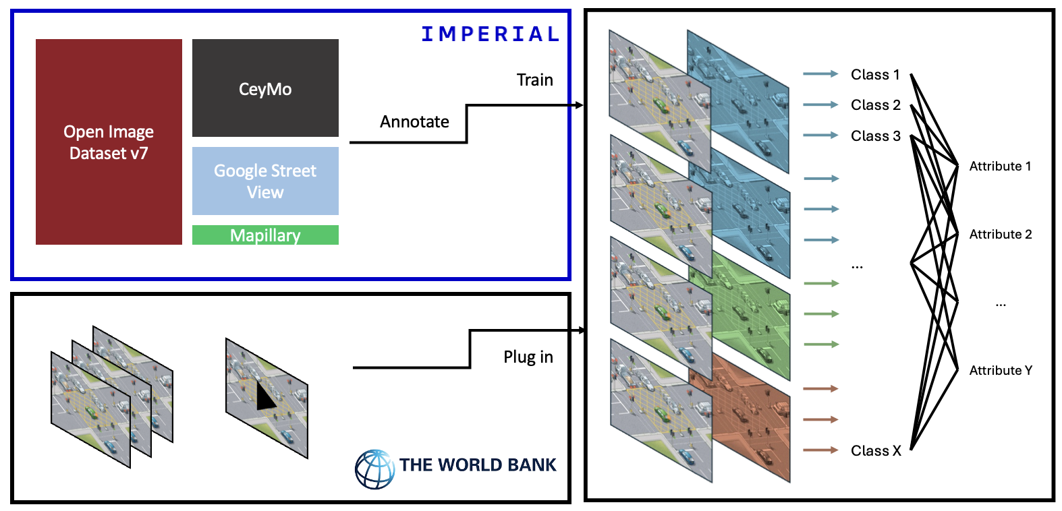
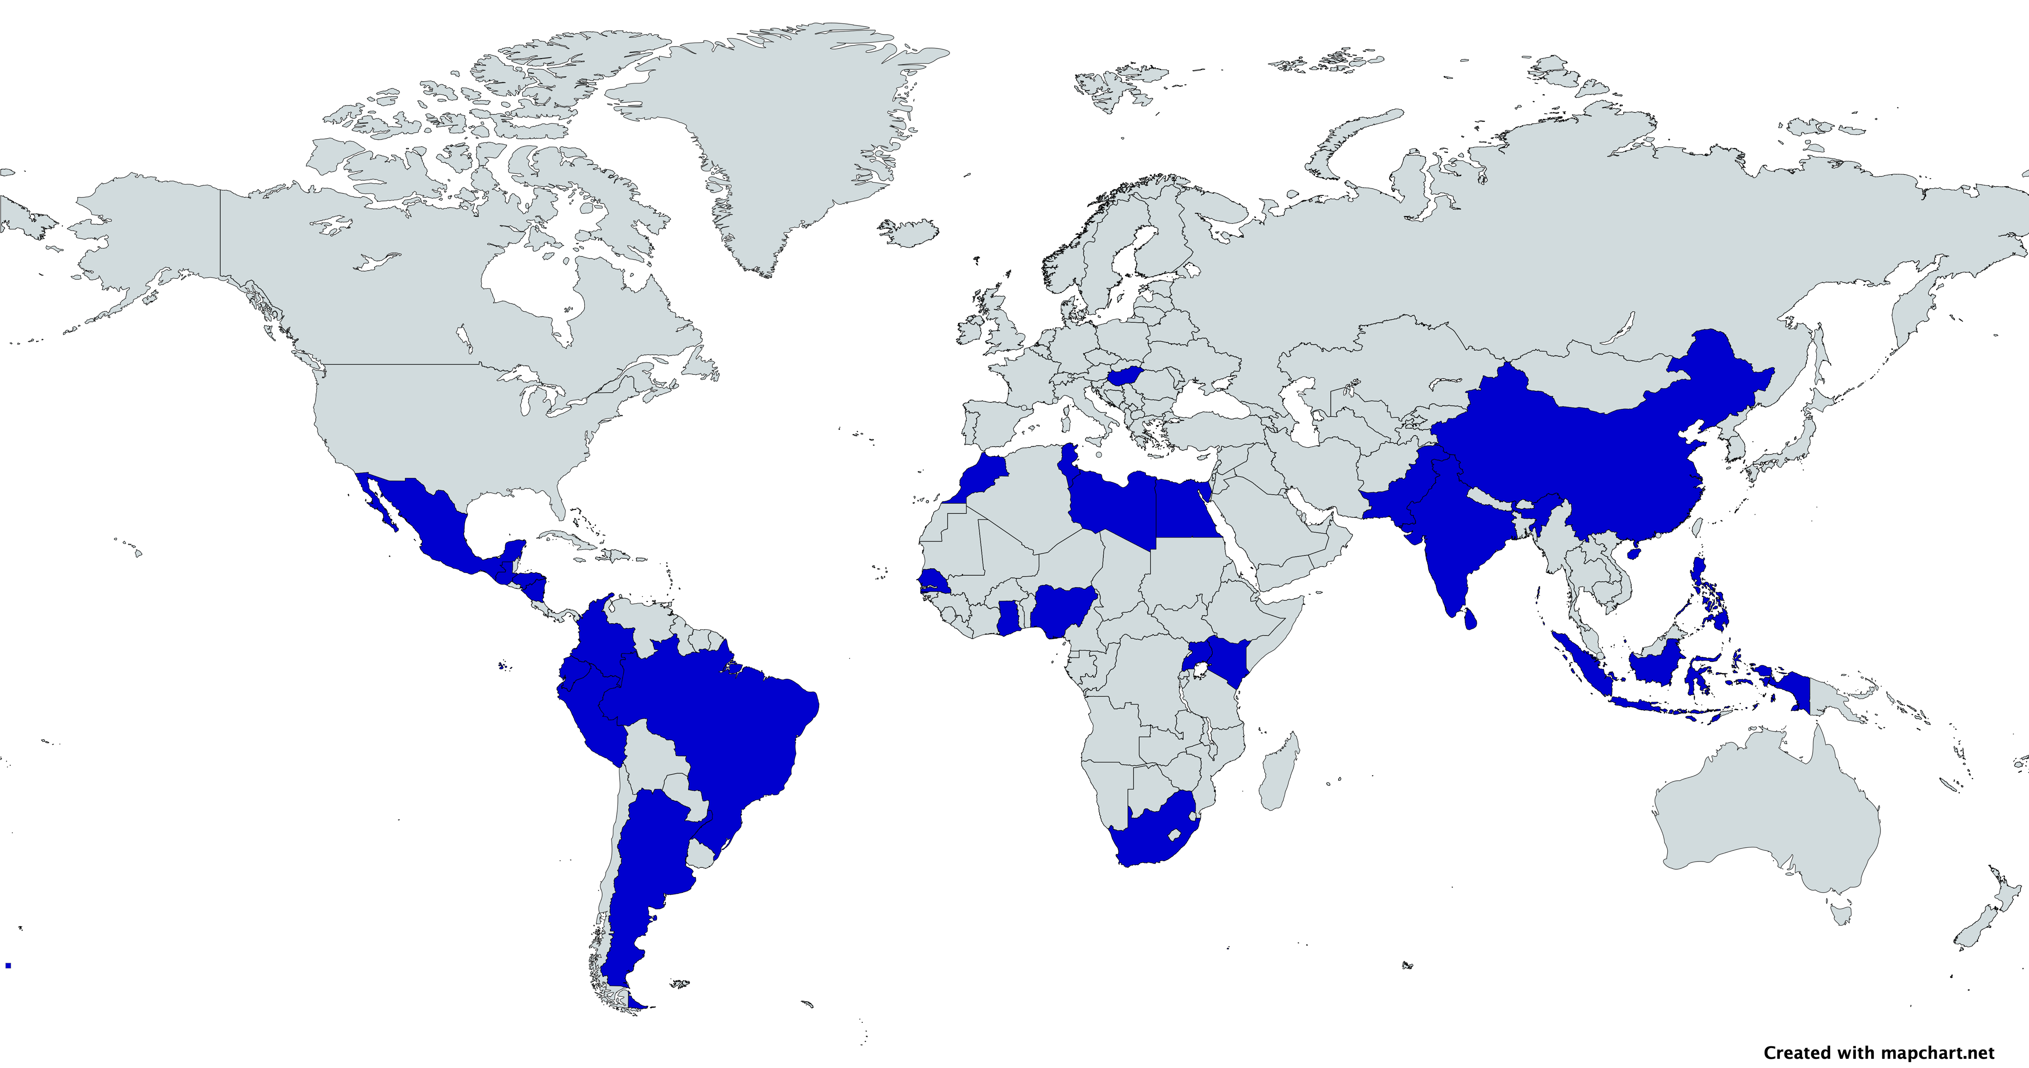
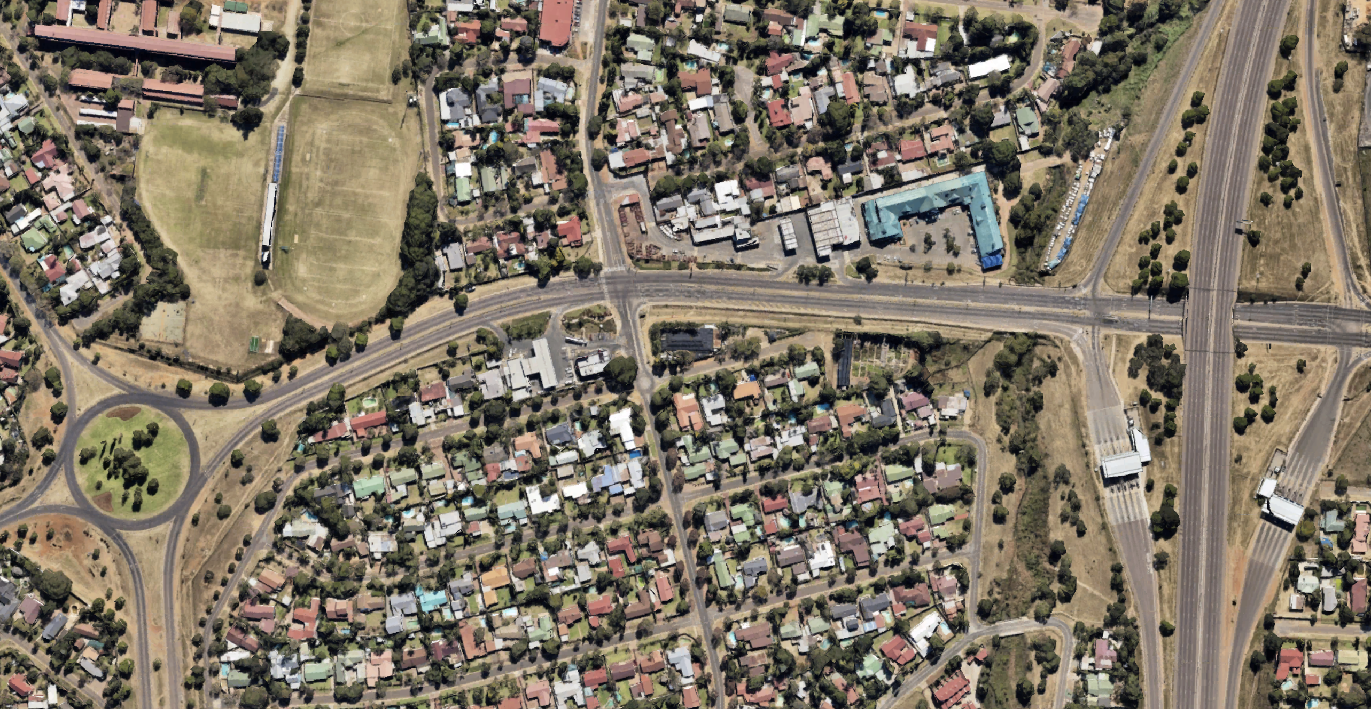
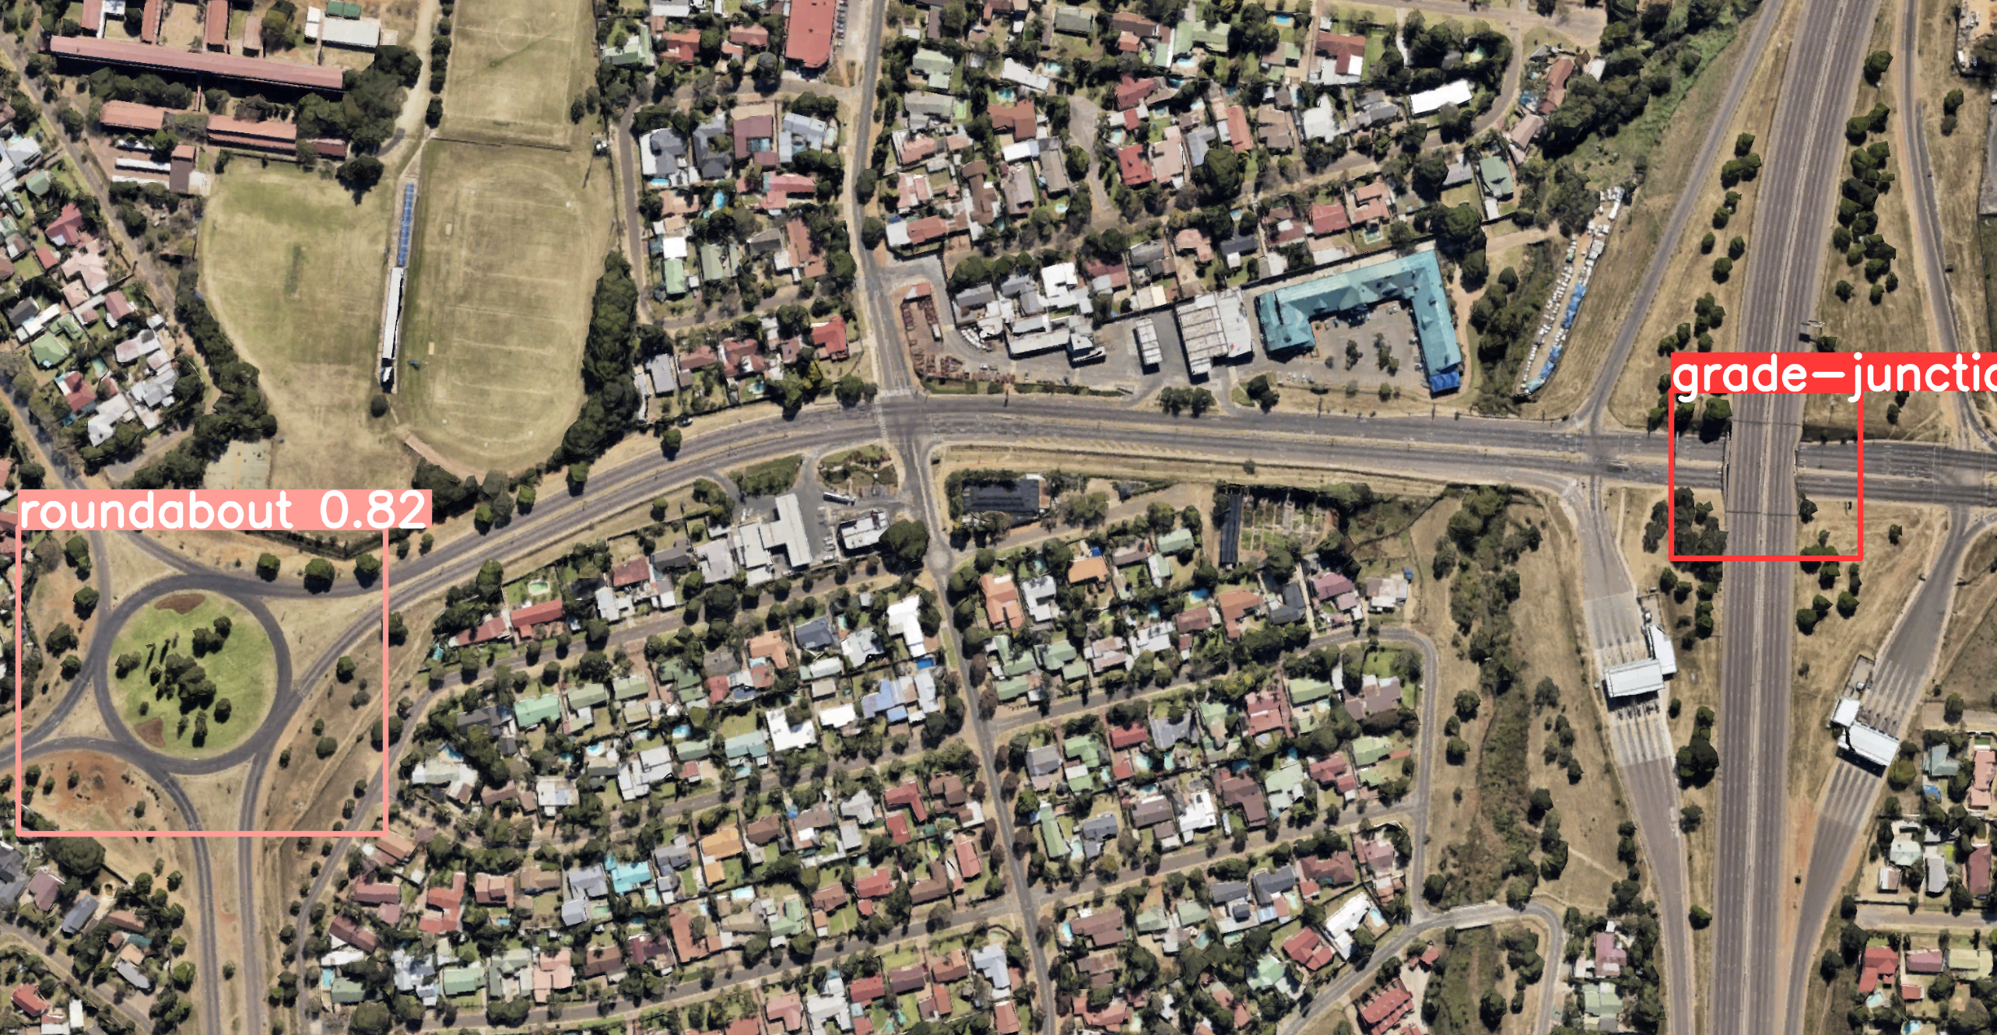
Internalising Road Safety in Project Funding
The Environmental and Social Framework of the World Bank requires that all financed projects proactively avoid or mitigate potential road safety risks and their impacts, to address traffic and road safety issues in low- and medium-income countries (LMICs).
To evaluate the road safety performance based on existing conditions, the World Bank developed the Road Safety Screening and Appraisal Tool (RSSAT). These evaluations are time-consuming and costly, hence there is a need for automation in detecting road features from videos and photos, particularly within the context of LMICs.
Multi-Layer Model
The Multi-Layer Model (MLM) aggregates ground level (model 1 & 2), aerial view (model 3), and lane & road marking (model 4) YOLOv8 models. It can detect 11 attributes of road safety: Segment characteristics, Dominant roadside object, Intersection characteristics, and Pedestrian crossings.
+30,000 images gathered from Open Image Dataset v7, CeyMo^{[1]}, Google Street View, and Mapillary over twenty-three LMIC.
Results of Multi-Layer Model
The key metrics (sensitivity, specificity, precision, and number of occurrences) are shown for each model and for every class in the table infra.
Novelty of the Research
Even though the leader of road object detection, Mapillary, already detects 65 road classes, it fails to detect: (1) median type such as: central hatching and safety barriers; (2) pedestrian facilities: the difference between a sidewalk and a protected sidewalk; (3) road intersections: neither roundabouts or grade junctions; while the developed MLM has this capability.
Moreover, this study focuses on datasets from LMICs, while other researches or databases focus only on developed regions and countries.
Limitations of the Project
Despite efforts to collect versatile data, some limitations remain when building the database:
Inconsistency in the quality of pictures
Lack of diversity in weather and light conditions meaning less unified algorithm
Lack of method to differentiate between urban and rural areas when collecting data
Some classes of attributes remain challenging to find adequate amounts of images in order to train the model (such as protected bike lane).
Recommendations for Future Work
To gather more data: strengthen cooperation with local authorities in order to facilitate the use of high precision equipment to update database
To ensure annotation quality: use semi-automated or crowdsourced methods to gain a uniform and comprehensive training dataset
To improve model robustness: expand the dataset to include more challenging scenarios, and deploy techniques such as data augmentation, transfer learning, and domain adaptation
To integrate a Digital Twin generator: track and extract every unique object GPS coordinate via Depth estimation methods.
Acknowledgments
The authors would like to thank Professor Mohammed Quddus, Shaofan Sheng, and Dr. Felix Feng of Imperial College London for the assistance and support they were able to provide.
References
[1] Liu, X., Deng, Z., Lu, H., and Cao, L., 2017. Benchmark for road marking detection: Dataset specification and performance baseline. In: 2017 IEEE 20th International Conference on Intelligent Transportation Systems (ITSC), pp. 1–6. IEEE.
Comparison between input picture and detection of classes for the 2nd model in Layer 1 of the MLM
 | Classes | Sensitivity | Specificity | Precision | Occurrences
Layer 1 Model 1 | Car | 0.691 | 0.918 | 0.724 | 1,444
 | Traffic light | 0.533 | 0.960 | 0.727 | 1,007
 | Traffic sign | 0.634 | 0.962 | 0.612 | 529
 | Tree | 0.413 | 0.870 | 0.571 | 1,799
Layer 1 Model 2 | Bike lane | 0.703 | 0.987 | 0.667 | 74
 | Central hatch | 0.560 | 0.996 | 0.636 | 25
 | Pedestrian Crossing | 0.680 | 0.968 | 0.576 | 122
 | Physical median | 0.617 | 0.943 | 0.559 | 214
 | Pole | 0.388 | 0.8941 | 0.591 | 580
 | Protected bike lane | 0.000 | 0.998 | 0.000 | 2
 | Protected sidewalk | 0.419 | 0.986 | 0.317 | 31
 | Safety barrier | 0.597 | 0.965 | 0.665 | 216
 | Sidewalk | 0.472 | 0.940 | 0.621 | 354
Layer 2 Model 3 | Grade junction | 0.527 | 0.875 | 0.611 | 110
 | Roundabout | 0.767 | 0.674 | 0.682 | 193
Layer 3 Model 4 | Arrow left | 0.833 | 0.999 | 0.833 | 18
 | Arrow right | 0.946 | 0.997 | 0.881 | 55
 | Arrow straight | 0.960 | 0.991 | 0.928 | 228
 | Arrow straight & left | 0.956 | 0.997 | 0.880 | 46
 | Arrow straight & right | 0.923 | 1.000 | 1.000 | 13
 | Bike lane | 1.000 | 1.000 | 1.000 | 11
 | Bus lane | 1.000 | 0.998 | 0.889 | 32
 | Pedestrian Crossing | 0.917 | 0.998 | 0.968 | 132
 | Diamond | 0.982 | 0.999 | 0.982 | 109
 | Line type 1 | 0.818 | 0.825 | 0.851 | 1,212
 | Line type 2 | 0.712 | 0.983 | 0.546 | 59
 | Slow sign | 1.000 | 1.000 | 1.000 | 21
 | Yellow mark | 0.966 | 0.999 | 0.933 | 29
Data base
MLM architecture
Comparison between input picture and detection of classes for the 3rd model in Layer 2 of the MLM

